Slide 1
9.6 Partial orderings

Slide 2
Content
Partial Order
  Linear order（线序）
  Quasiorder（拟序）
  Product Partial Order（乘积偏序）
  Lexicographic Order（词典顺序）
Hasse Diagram（哈斯图）
Topological Sorting（拓扑排序）
Isomorphism（同构）
Principle of Correspondence（对应原理）
*
School of Computer Science, BUPT
*

Slide 3
Review
Properties of relations on a set A:
  Reflexive(自反的）
  Irreflexive（反自反的）
  Symmetric（对称的）
  Asymmetric（非对称的）
  Antisymmetric（反对称的）
  Transitive（传递的）
*
School of Computer Science, BUPT
*

Slide 4
PARTIALLY ORDERED SETS (偏序集合）
Partial order（偏序关系）:A relation R on a set A is called a partial order if R is reflexive（自反）, antisymmetric（反对称）, and transitive（传递）.
Partially ordered set:The set A together with the partial order R is called a partially ordered set, or simply a poset, and we will denote this poset by (A, R).
*
School of Computer Science, BUPT
*

Slide 5

多选题
1分
Which of these are posets
A
(⁺,≤) 
B
( ⁺,≥)
C
(⁺,|)
D
(⁺,<)
提交
*

Slide 6
linear order（线序关系）
If (A, ≤) is a poset, the elements a and b are said to be
  Comparable（可比的） if a ≤ b or b ≤ a.
  incomparable (不可比的）if neither a ≤ b nor b ≤ a.
If every pair of elements in a poset A is comparable, we say that A is a linearly ordered set（全序集合）or totally ordered, and the partial order is called a linear order（全序关系或线序关系）. We also say that A is a chain（链）.
  (⁺,≤)
  (⁺,|) is not a chain.
*
School of Computer Science, BUPT
*

Slide 7
Well-ordered set
Well-ordered set:The poset A together with the total ordering R and such that every nonempty subset of A has a least element is called a well-ordered set.
  The set of ordered pairs of positive integers Z⁺× Z⁺, with (a₁, a₂) (b₁, b₂) if a₁ < b₁, or if a₁ = b₁ and a₂ ≤ b₂ (the lexicographic ordering), is a well-ordered set.
  The set Z, with the usual ≤ ordering, is not well-ordered.
≼
*
School of Computer Science, BUPT
*

Slide 8
Theorem 1 The principle of well-ordered induction
Suppose that S is a well ordered set. Then P(x) is true for all x∈S, if（INDUCTIVE STEP） For every y∈S, if P(x) is true for all x∈S with x<y, then P(y) is true.
Proof: Suppose it is not the case that P(x) is true for all x∈S.
Then there is an element y∈S such that P(y) is false.
the set A = {x ∈ S ∣P(x) is false} is nonempty.
Because S is well-ordered, A has a least element a.
By the choice of a as a least element of A, P(x) is true for all x∈ S with x <a. This implies by the inductive step P(a) is true.
This contradiction shows that P(x) must be true for all x ∈ S.
Remark:P(x₀) is true. (using a vacuous proof)
*
School of Computer Science, BUPT
*

Slide 9
Quasiorder(拟序关系）
Quasiorder: A relation R on a set A is called quasiorder if it is transitive and irreflexive.
  Example:
    (P(S),⊂)
*
School of Computer Science, BUPT
*

Slide 10
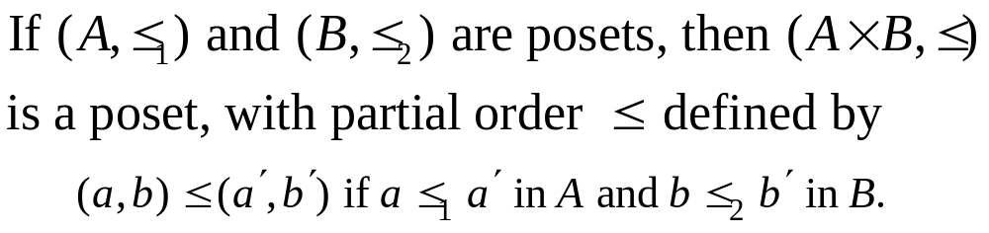
Product partial order（乘积偏序）
This ordering is called product partial order.
*
School of Computer Science, BUPT
*

Slide 11
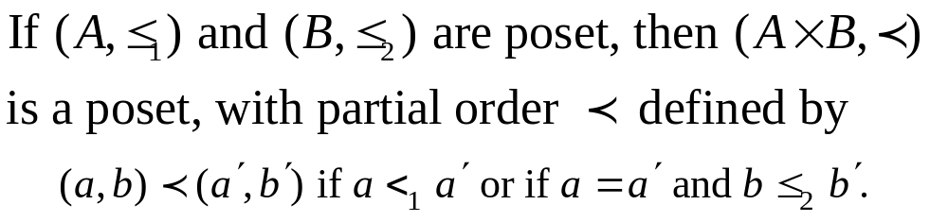
Lexicographic order（词典顺序）
This ordering is called lexicographic, or “dictionary” order.
*
School of Computer Science, BUPT
*

Slide 12
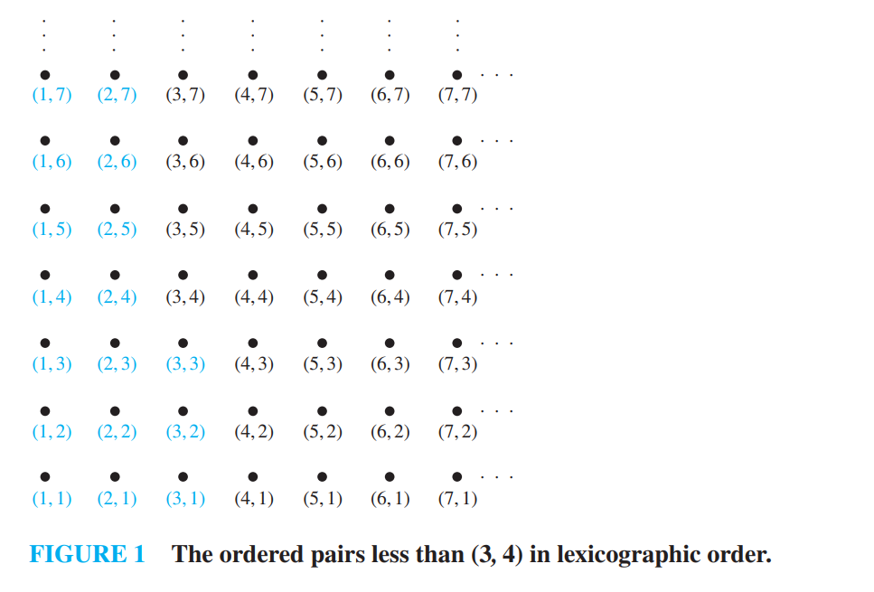
example
*

Slide 13
Define the partial ordering on A₁×A₂ × ⋯ ×A_{n} by (a₁, a₂, … , a_{n}) ≺ (b₁, b₂, … , b_{n}) if a₁≺₁ b₁, or if there is an integer i > 0 such that a₁ = b₁, … , a_{i} = b_{i} , and a_{i+1} ≺_{i+1} b_{i+1}.
  (1, 2, 3, 5) ≺ (1, 2, 4, 3)
  discreet ≺ discrete
≼
*

Slide 14
Hasse Diagrams（哈斯图）
Hasse Diagram is the digraph of a partial order on a finite set A that
  deletes all self-cycles
  eliminates all edges that are implied by the transitive property
  draws the digraph with all edges pointing upward
*
School of Computer Science, BUPT
*

Slide 15
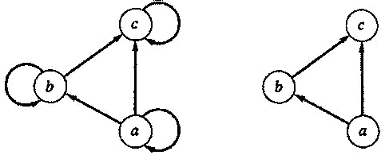
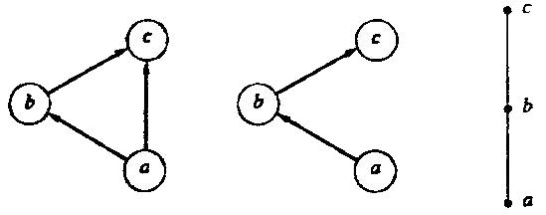
Hasse Diagram
*
School of Computer Science, BUPT
*

Slide 16
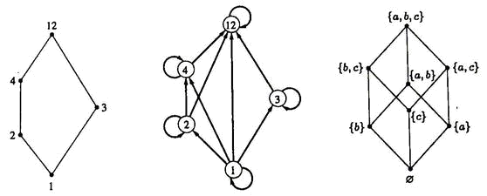
Hasse Diagram
({1, 2, 3, 4, 12}, |)
(P({a, b, c}), ⊆)
*
School of Computer Science, BUPT
*

Slide 17
Isomorphism（同构）
Let (A, ≤) and (A’, ≤’) be posets and let f :A→A’ be a one-to-one correspondence between A and A’. The function f is called an isomorphism from (A, ≤) to (A’, ≤’) if, for any a and b in A,
  a ≤ b if and only if f(a) ≤’ f(b).
If f : A→A’ is an isomorphism, we say that (A, ≤) and (A’, ≤’) are isomorphic posets.
*
School of Computer Science, BUPT
*

Slide 18
Isomorphism: Example
Let (Z⁺, ≤) and (E⁺, ≤) be posets. The function f : Z⁺ → E⁺ given by
  f(a) = 2a
is an isomorphism from (Z⁺ , ≤) to (E⁺ , ≤)
Proof
  First, is onto and one-to-one
  Second, a ≤ b iff 2a ≤ 2b
*
School of Computer Science, BUPT
*

Slide 19
Principle of correspondence （对应原理）
Suppose that f：A→A’ is an isomorphism from a poset (A, ≤) to a poset (A’, ≤’). Suppose also that B is a subset of A, and B’ = f(B) is the corresponding subset of A’. Then
  If the elements of B have any property relating to one another or to other elements of A, and if this property can be defined entirely in terms of the relation ≤, then the elements of B’ must possess exactly the same property, defined in terms of ≤’ .
  two finite isomorphic posets must have the same Hasse diagram.
*
School of Computer Science, BUPT
*

Slide 20
Extremal elements
maximal element（极大元）
minimal element（极小元）
greatest element（最大元）
  denoted by I and often called the unit element（单位元）
least element（最小元）
  denoted by 0 and often called the zero element（零元）
*
School of Computer Science, BUPT
*

Slide 21
Maximal(minimal) element
An element a ∈ A is called a maximal element of A if there is no element c in A such that a<c.
An element b ∈ A is called a minimal element of A if there is no element c in A such that c<b.
*
School of Computer Science, BUPT
*

Slide 22
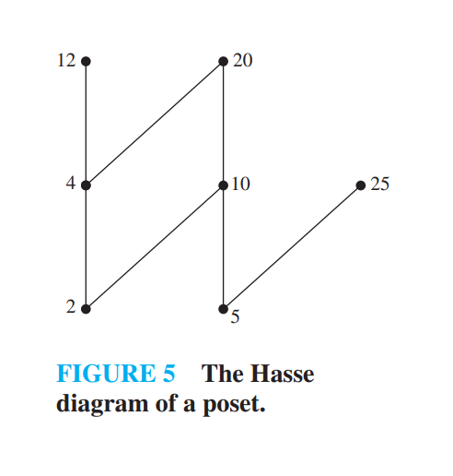
example
Which elements of the poset ({2, 4, 5, 10, 12, 20, 25}, ∣) are maximal, and which are minimal?
*

Slide 23
Greatest (least ) element
An element a ∈A is called a greatest element of A if x ≤ a for all x ∈ A.
An element a ∈A is called a least element of A if a ≤ x for all x ∈ A.
The greatest element of a poset, if it exists, is denoted by I, and is often called the unit element. Similarly, the least element is called zero element.
*
School of Computer Science, BUPT
*

Slide 24
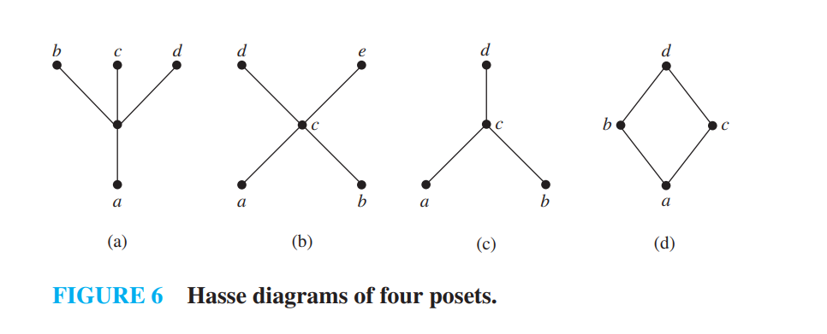
example
Determine whether the posets represented by each of the Hasse diagrams in Figure 6 have a greatest element and a least element.
*

Slide 25
Lub（最小上界） Glb（最大下界）
Consider a poset and a subset B of A.
  An element a ∈ A is called a upper bound（上界） of B if b≤a for all b ∈ B.
  An element a ∈ A is called a lower bound（下界）of B if a≤b for all b ∈ B.
  An element a ∈ A is called a least upper bound (LUB) of B if a is an upper bound of B and a≤a’, whenever a’ is an upper bound of B.
  An element a ∈ A is called a greatest lower bound (GLB) of B if a is an lower bound of B and a’≤a, whenever a’ is an lower bound of B.
*
School of Computer Science, BUPT
*

Slide 26
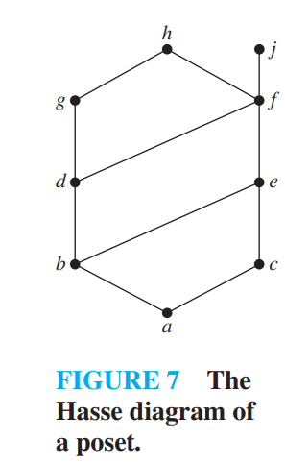
example
Find the lower and upper bounds of the subsets {a, b, c}, {j, h}, and {a, c, d, f } in the poset with the Hasse diagram shown in Figure 7.
Find the greatest lower bound and the least upper bound of {b, d, g}, if they exist, in the poset shown in Figure 7.
*

Slide 27
Theorem
Let (A, ≤) be a poset
  If A is a finite nonempty, then A has at least one maximal element and at least one minimal element.
  A has at most one greatest element and at most one least element.
  A subset B of A has at most one LUB and at most one GLB.
*
School of Computer Science, BUPT
*

Slide 28
Theorem
Suppose that (A, ≤) and (A’, ≤’) are isomorphic posets under the isomorphism f: A→A’.
  If a is a maximal (minimal) element of (A, ≤), then f(a) is a maximal (minimal) element of (A’, ≤’).
  If a is a greatest (least) element of (A, ≤), then f(a) is a greatest (least) element of (A’, ≤’).
  If a is an upper bound (lower bound, least upper bound, greatest lower bound) of (A, ≤), then f(a) is an upper bound (lower bound, least upper bound, greatest lower bound) of (A’, ≤’).
  If every subset of (A, ≤) has a LUB (GLB), then every subset of (A’, ≤’) has a LUB (GLB).
*
School of Computer Science, BUPT
*

Slide 29
Topological Sorting
（拓扑排序）
If A is a poset with partial order ≤, we sometimes need to find a linear order  for the set A that will merely be an extension of the given partial order in the sense that if a ≤ b, then a  b.
The process of constructing a linear order such as  is called topological sorting
*
School of Computer Science, BUPT
*

Slide 30
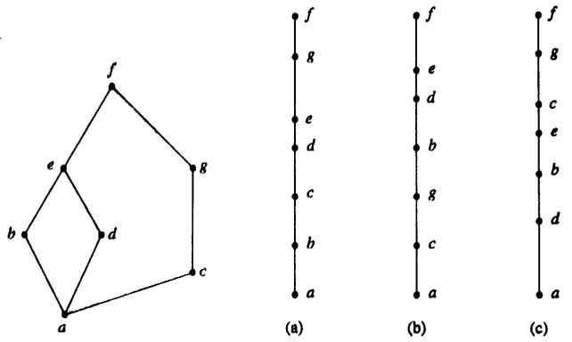
Example
*
School of Computer Science, BUPT
*

Slide 31
SORT Algorithm
For finding a topological sorting of a finite poset (A, ≤).
Step1 Choose a minimal element a of A.
Step2 Make a the next entry of SORT and replace A with A-{a}.
Step3 Repeat steps 1 and 2 until A={}.
End of Algorithm
*
School of Computer Science, BUPT
*

Slide 32
Lattice
A lattice is a poset in which every subset {a,b} consisting of two elements has a least upper bound and a greatest lower bound.
  denote LUB({a,b}) by a∨b and call it the join（并） of a and b.
  denote GLB({a,b}) by a∧b and call it the meet（交） of a and b.
*
School of Computer Science, BUPT
*

Slide 33
Example
Let S be a set and let L = P(S).
  As we have seen, ⊆, containment, is a partial order on L. Let A and B belong to the poset (L, ⊆).
A∨B is the set A∪B.
  To see that, note that A⊆A∪B, B ⊆ A∪B, and if A ⊆ C and B ⊆ C, then it follows that A∪B ⊆ C.
Similarly, A∧B is the set A∩B.
Thus, L is a lattice.
*
School of Computer Science, BUPT
*

Slide 34
Example
S={a,b,c}
{a,b,c}
{a,c}
{b,c}
{a,b}
{c}
{a}
{b}
{}
*
School of Computer Science, BUPT
*

Slide 35
Example
Let n be a positive integer and D_{n} be the set of all positive divisors of n.
D₃₀={1,2,3,5,6,10,15,30}
  a ∨ b=LCM(a,b)
  a ∧ b=GCD(a,b)
30
10
15
6
2
5
3
1
*
School of Computer Science, BUPT
*

Slide 36
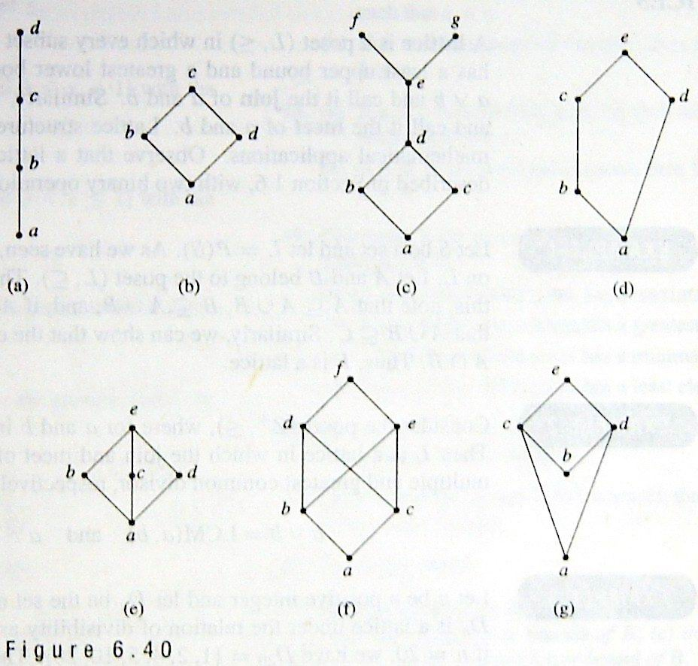
Determine whether the posets with these Hasse diagrams are lattices.
*
School of Computer Science, BUPT
*

Slide 37
Theorem
If (L₁, ≤₁) and (L₂, ≤₂) are lattices, then (L, ≤) is a lattice, where
  L = L₁×L₂
  the partial order ≤ of L is the product partial order.
*
School of Computer Science, BUPT
*

Slide 38
Proof
We denote the join and meet in L₁ by ∨₁ and∧₁, respectively, and the join and meet in L₂ by ∨₂ and ∧₂, respectively. Then L is a poset.
We now need to show that if (a₁, b₁) and (a₂, b₂)∈L, then (a₁, b₁)∨(a₂, b₂) and (a₁, b₁)∧(a₂, b₂) exist in L. We leave it as an exercise to verify that
  (a₁, b₁)∨(a₂, b₂) = (a₁ ∨₁ a₂, b₁ ∨₂ b₂)
  (a₁, b₁)∧(a₂, b₂) = (a₁ ∧₁ a₂, b₁ ∧₂ b₂).
Thus L is a lattice.
*
School of Computer Science, BUPT
*

Slide 39
Example
L₁ L_{2’} =L₁ × L₁ L₂ L= L₁× L₂
(1₁ ,1₂)
1₁
(1₁ ,1₁)
1₂
(1₁ ,a)
(1₁ ,b)
(0₁ ,1₂)
(0₁ ,1₁)
a
b
(1₁ ,0₁)
(1₁ ,0₂)
(0₁ ,a)
(0₁ ,b)
0₁
(0₁ ,0₁)
0₂
(0₁ ,0₂)
*
School of Computer Science, BUPT
*

Slide 40
Sublattice（子格）
Let (L, ≤) be a lattice. A nonempty subset S of L is called a sublattice of L
  if a∨b ∈ S and a∧b∈S whenever a ∈ S and b ∈ S.
Example : (D_{n}, |) is a sublattice of (Z⁺, |)
*
School of Computer Science, BUPT
*

Slide 41
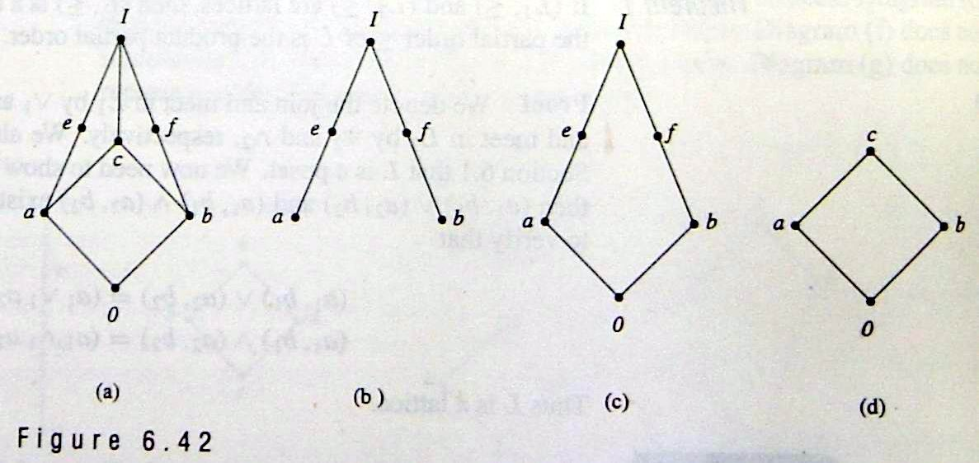
多选题
1分
Which of those are sublattice of the lattice shown in figure (a)?
B
b
C
c
D
d
提交
*

Slide 42
Isomorphic Lattices（同构格）
If f: L₁→L₂ is an isomorphism from the poset (L₁, ≤₁) to the poset (L₂, ≤₂)
  L₁ is a lattice if and only if L₂ is a lattice.
  If a and b are elements of L₁, then
    f(a∧b) = f(a) ∧ f(b)
    f(a∨b) = f(a) ∨ f(b).
If two lattices are isomorphic, as posets, we say they are Isomorphic Lattices.
*
School of Computer Science, BUPT
*

Slide 43
Properties of Lattices
Recall the meaning of a∨b and a∧b:
  a ≤ a∨b and b ≤ a∨b ; a∨b is an upper bound of a and b.
  If a ≤ c and b ≤ c , then a∨b ≤ c; a∨b is the least upper bound of a and b.
  a ∧ b ≤ a and a ∧ b ≤ b ; a ∧ b is an lower bound of a and b.
  If c ≤ a and c ≤ b, then c ≤ a ∧ b; a ∧ b is the greatest lower bound of a and b.
*
School of Computer Science, BUPT
*

Slide 44
Theorem
Let L be a lattice. Then for every a and b in L,
  a∨b = b if and only if a≤b.
  a∧b = a if and only if a≤b.
  a∧b = a if and only if a∨b = b
*
School of Computer Science, BUPT
*

Slide 45
Proof of a∨b = b if and only if a≤b.
⇒ only if
  Suppose a∨b = b, so a∨b ≤ b (reflexive)
  a∨b is an upper bound of a and b, so a ≤ a∨b
  So, a ≤ b (transitive)
⇐ if
  Suppose a≤b
  b≤b (reflexive), b is an upper bound of a and b
  So a∨b≤b (by definition of lub)
  But, b≤a∨b (by definition of ub)
  Therefore, a∨b = b (antisymmetric)
*
School of Computer Science, BUPT
*

Slide 46
Theorem
Let L be a lattice. Then
  Idempotent Properties（等幂律）
    (a) a∨a = a
    (b) a∧a = a
  Commutative Properties（交换律）
    (a) a∨b = b∨a
    (b) a∧b = b∧a
  Associative Properties（结合律）
    (a) a∨(b∨c) = (a∨b)∨c
    (b) a∧(b∧c) = (a∧b) ∧c
  Absorption Properties（吸收律）
    (a) a∨(a∧b) = a
    (b) a∧(a∨b) = a
*
School of Computer Science, BUPT
*

Slide 47
Proof of 4. (a)
Since a∧b≤a and a≤a, we see that a is an upper bound of a∧b and a; so a∨(a∧b)≤a. On the other hand, by the definition of LUB, we have a≤a∨(a∧b), so a∨(a∧b) = a.
  Q.E.D
It follows from property 3 that we can write a∨(b∨c) and (a∨b) ∨c merely as a∨b∨c, and similarly for a∧b∧c.
*
School of Computer Science, BUPT
*

Slide 48
Theorem
Let L be a lattice. Then for every a, b, and c in L,
If a≤b, then
  a∨c ≤ b∨c.
  a∧c ≤ b∧c.
a≤c and b≤c if and only if a∨b≤c.
c≤a and c≤b if and only if c≤a∧b.
If a≤b and c≤d, then
  a∨c ≤ b∨d.
  a∧c ≤ b∧d.
*
School of Computer Science, BUPT
*

Slide 49
Special Types of Lattices
A lattice L is said to be bounded（有界的） if it has a greatest element I and a least element 0
*
School of Computer Science, BUPT
*

Slide 50
Example
The lattice P(S) of all subsets of a set S, as defined in Example 1, is bounded. Its greatest element is S and its least element is ∅
If L is a bounded lattice, then for all a ∈ A,
  0 ≤a≤I
  a∨0 = a
  a∧0 = 0
  a∨I = I
  a∧I = a
*
School of Computer Science, BUPT
*

Slide 51
Theorem
Let L = {a₁, a₂, …, a_{n}} be a finite lattice. Then L is bounded.
Proof
  The greatest element of L is a₁∨a₂∨… ∨a_{n},
  and its least element is a₁∧a₂∧…∧a_{n}
*
School of Computer Science, BUPT
*

Slide 52
Distributive lattice（分配格）
A lattice is called distributive if for any elements a, b, and c in L we have the following distributive properties.
  a∧(b∨c) = (a∧b)∨(a∧c)
  a∨(b∧c) = (a∨b)∧(a∨c)
If L is not distributive, we say that L is nondistributive
*
School of Computer Science, BUPT
*

Slide 53
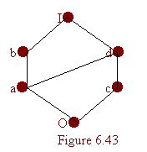
Example
The lattice shown in Figure 6.43 is distributive, as can be seen by verifying the distributive properties for all ordered triples chosen from the elements a, b, c, and d.
*
School of Computer Science, BUPT
*

Slide 54
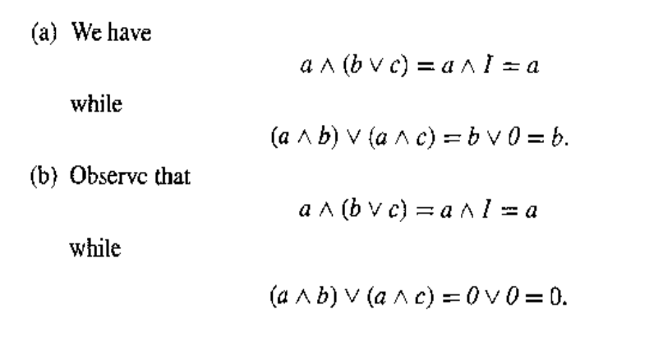
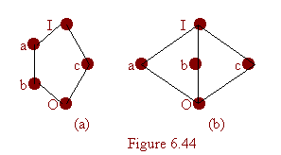
nondistributive lattices
The lattice shown in Figure 6.44 are nondistributive.
*
School of Computer Science, BUPT
*

Slide 55
Theorem
A lattic L is nondistributive if and only if it contains a sublattice that is isomorphic to one of the above two lattices.
Proof:
  omitted
*
School of Computer Science, BUPT
*

Slide 56
Complement（补元）
Let L be a bounded lattice with greatest element I and least element 0, and let a ∈ L. An element a’ L is called a complement of a if
  a∨a’ = I and a∧a’ = 0
Note that
  0’ = I and I’ = 0.
An element a in a lattice need not have a complement, and it may have more than one complement.
*
School of Computer Science, BUPT
*

Slide 57
Example
The lattices in Figure 6.44 each have the property that every element has a complement. The element c in both cases has two complements, a and b.
*
School of Computer Science, BUPT
*

Slide 58
Theorem
Let L be a bounded distributive lattice. If a complement exists, it is unique.
(1₁ ,1₂)
(1₁ ,a)
(1₁ ,b)
(0₁ ,1₂)
(1₁ ,0₂)
(0₁ ,a)
(0₁ ,b)
(0₁ ,0₂)
*
School of Computer Science, BUPT
*

Slide 59
Proof
Let a’ and a’’ be complements of the element a∈L. Then
  a∨a’ = I, a∨a’’ = I, a∧a’ = 0, a∧a’’ = 0.
Using the distributive laws, we obtain
  a’ = a’∨0 = a’∨(a∧a’’) = (a’∨a) ∧(a’∨a’’) = I∧(a’ ∨a’’) = a’∨a’’
Also
  a’’ = a’’∨0 = a’’∨(a∧a’)= (a’’∨a)∧(a’’∨a’) = I∧(a’’∨a’) = a’∨a’’
Hence a’ = a’’.
*
School of Computer Science, BUPT
*

Slide 60
Complemented（有补格）
A lattice is called complemented if it is bounded and if every element in L has a complement.
In this case, the complements are not unique.
*
School of Computer Science, BUPT
*

Slide 61
Homework
§9.6
  12, 28, 35, 44
*
School of Computer Science, BUPT
*

